Slide 1
Power EnJoy
Electric car sharing system
01/03/2017

Slide 2
Actors involved
A person not registered to Power EnJoy or not logged into the system
PERSON
EMPOYEES
A person registered to Power EnJoy and logged in
An employee responsible for the car retrieval
USERS

Slide 3
Relevant concepts
A person not registered to Power EnJoy or not logged into the system
POWER GRID STATION
SAFE AREA
POWER ENJOY CAR
Public car parks, specific areas of the city and private PowerEnJoy car parks
Electric powered vehicles owned by PowerEnJoy.

Slide 4
States of a car
the car was in a safe area
AVAILABLE
car reservation
car retrieval
reservation expires
NOT AVAILABLE
RESERVED
the car was in a non-safe area or “battery distance constraint”
safe area parking after 1 hour
parking before 1h
unlocking and ignition
DISLOCATED
RUNNING
non-safe area parking after 1 hour or ”battery distance constraint”

Slide 5
Car reservation
• Tap on “reserve a car”
•

Slide 6
Extra fees and discounts
Only the highest percentage discount is applied
No discounts is applied if any extra fee is charged
Extra charges are applied cumulatively
RATIONALE: we want to discourage negative behavior from the users and to prevent the users from abusing the discount system

Slide 7
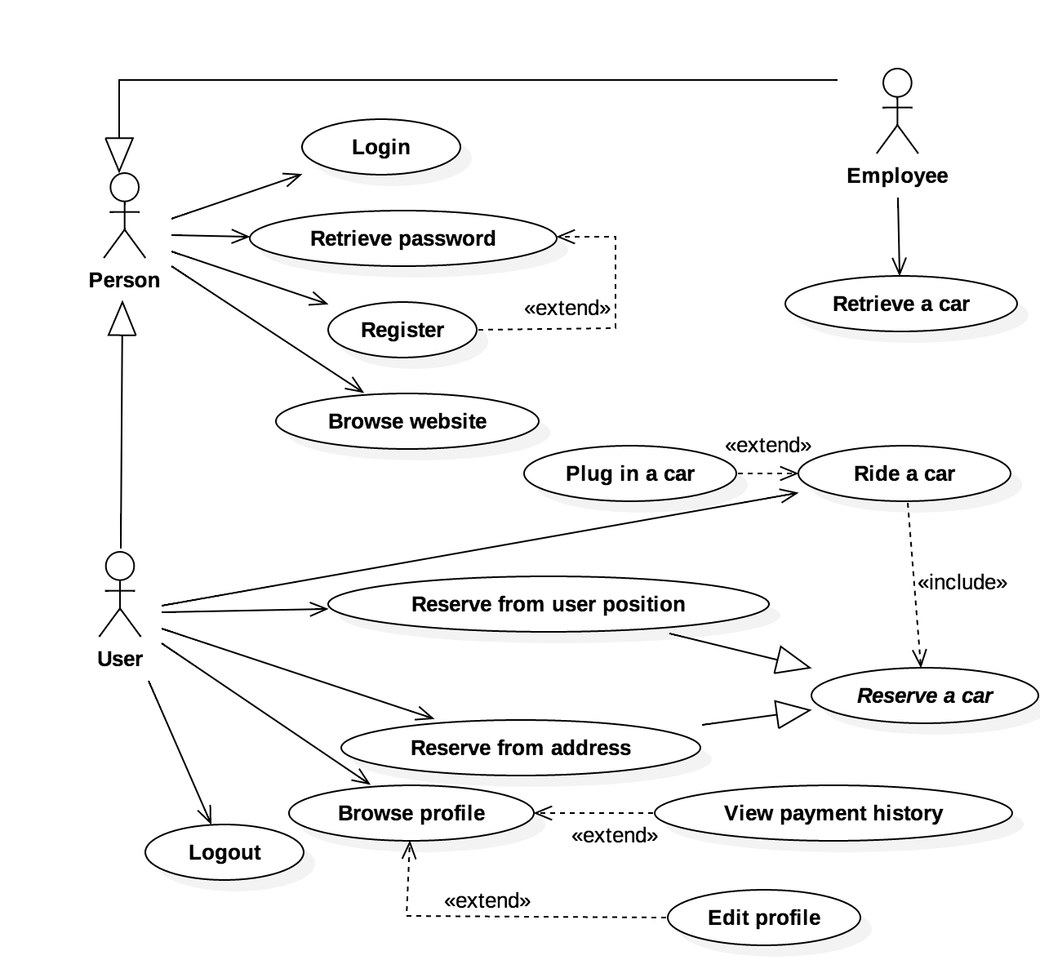
Elicited functionalities

Slide 8
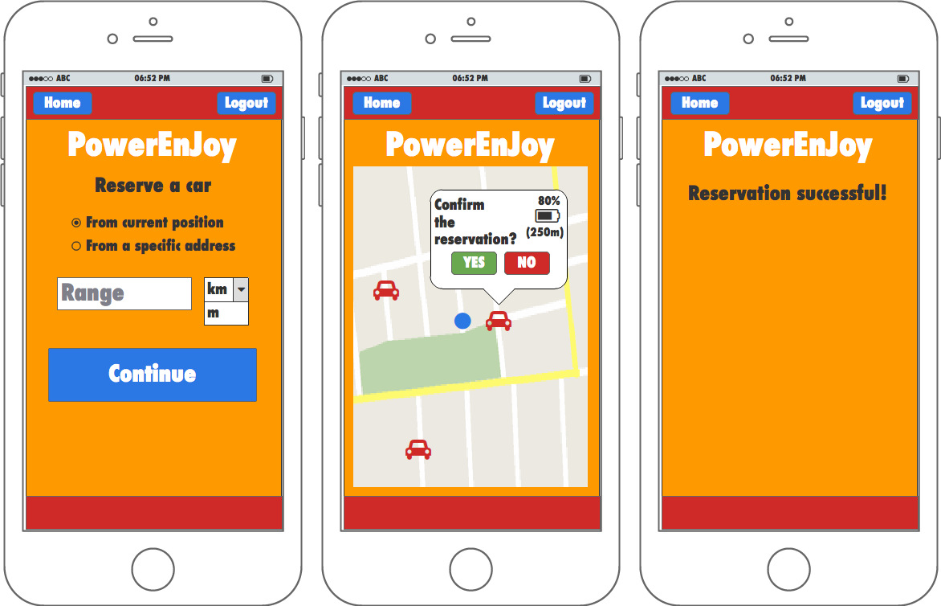
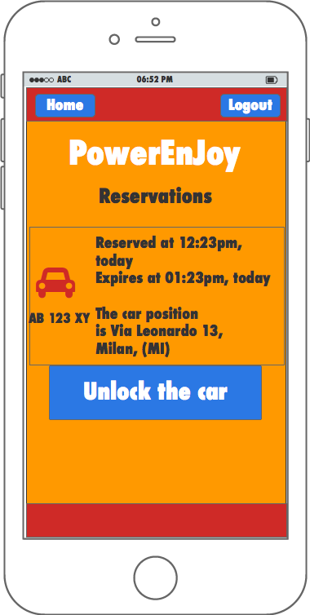
Look and feel

